Slide 1


Shamika Konara
08/07/2024

Slide 2

Outline
Executive Summary
Introduction
Methodology
Results
Conclusion
Appendix

Slide 3
Executive Summary
In this capstone project, we aim to predict whether the SpaceX Falcon 9 first stage will land successfully using various machine learning classification algorithms.
The primary steps in this project include:
Data collection, wrangling, and formatting
Exploratory data analysis
Interactive data visualization
Machine learning prediction
Our analysis indicates that certain features of the rocket launches correlate with the launch outcomes, i.e., success or failure. Based on our findings, we conclude that the decision tree algorithm may be the most effective for predicting the successful landing of the Falcon 9 first stage.

Slide 4
Introduction
In this capstone project, we aim to predict whether the Falcon 9 first stage will land successfully. SpaceX advertises Falcon 9 rocket launches on its website at a cost of 62 million dollars, significantly lower than the 165 million dollars charged by other providers. This cost efficiency is largely due to SpaceX's ability to reuse the first stage of the rocket. By accurately predicting the landing success of the first stage, we can better estimate the cost of a launch.
This information could be valuable for alternate companies looking to bid against SpaceX for rocket launch contracts.It is important to note that many unsuccessful landings are intentional, as SpaceX occasionally opts for a controlled landing in the ocean.
The primary question we seek to answer is: given a set of features about a Falcon 9 rocket launch, including payload mass, orbit type, launch site, and others, can we predict whether the first stage of the rocket will land successfully?

Slide 5

Section 1

Slide 6
Methodology
The overall methodology includes:
Data collection, wrangling, and formatting, using:
SpaceX API
Web scraping
Exploratory data analysis (EDA), using:
Pandas and NumPy
SQL
Data visualization, using:
Matplotlib and Seaborn
Folium
Dash
Machine learning prediction, using
Logistic regression
Support vector machine (SVM)
Decision tree
K-nearest neighbors (KNN)

Slide 7
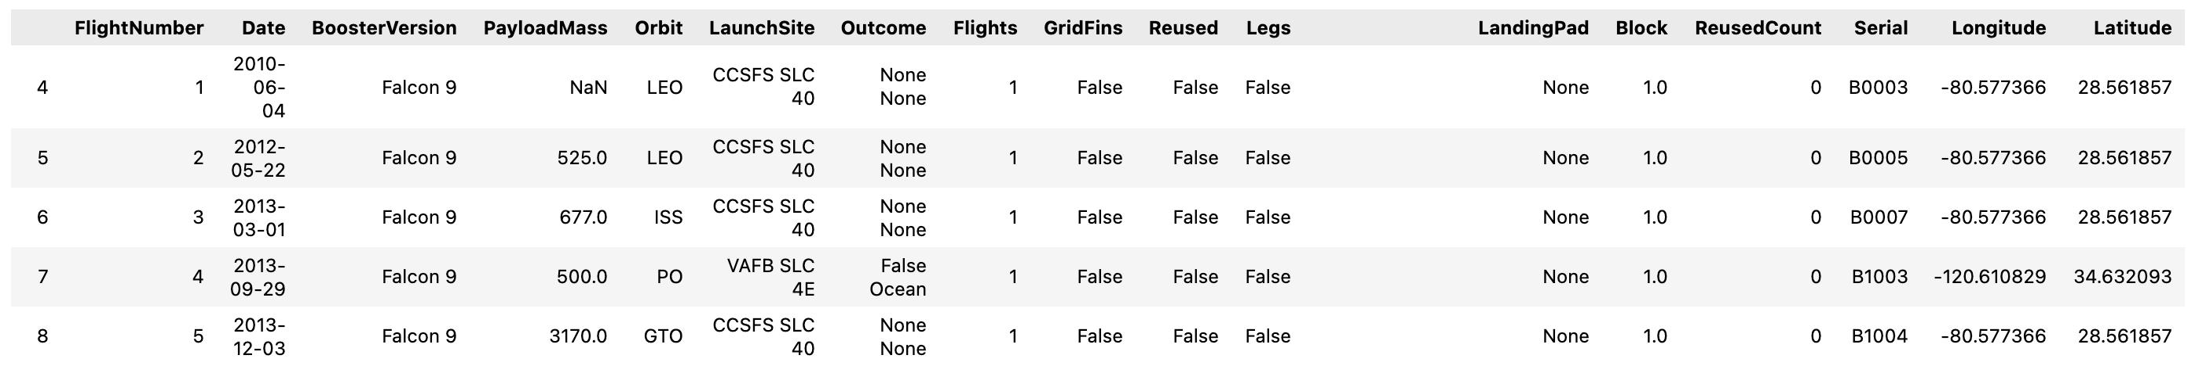
Data Collection – SpaceX API
The API utilized for this project is https://api.spacexdata.com/v4/rockets/, which provides detailed data on various rocket launches conducted by SpaceX. For the purposes of this analysis, the data has been filtered to include only Falcon 9 launches.
To handle missing values, each missing entry is replaced with the mean of the respective column. After processing, the dataset comprises 90 rows (instances) and 17 columns (features). The image below displays the first few rows of the filtered and cleaned data:

Slide 8

Data Collection - Scraping
Web scraping
The data is scraped from https://en.wikipedia.org/w/index.php?title=List_of_Falcon_9_and_Falcon_Heavy_launches&oldid=1027686922
The website contains only the data about Falcon 9 launches.
We end up with 121 rows or instances and 11 columns or features. The picture below shows the first few rows of the data:

Slide 9
Data Wrangling
The data is later processed so that there are no missing entries and categorical features are encoded using one-hot encoding.
An extra column called ‘Class’ is also added to the data frame. The column ‘Class’ contains 0 if a given launch is failed and 1 if it is successful.
In the end, we end up with 90 rows or instances and 83 columns or features.

Slide 10
EDA with Data Visualization
Pandas and NumPy
Functions from the Pandas and NumPy libraries are utilized to derive basic information about the collected data, including:
The number of launches at each launch site
The frequency of each orbit type
The number and frequency of each mission outcome
SQL
SQL queries are used to extract and analyze specific details from the data, such as:
The names of the unique launch sites involved in the space missions
The total payload mass carried by boosters launched by NASA (CRS)
The average payload mass carried by booster version F9 v1.1
Matplotlib and Seaborn
Functions from the Matplotlib and Seaborn libraries are used to visualize the data through scatterplots, bar charts, and line charts. The plots and charts are used to understand more about the relationships between several features, such as:
The relationship between flight number and launch site
The relationship between payload mass and launch site
The relationship between success rate and orbit type

Slide 11
EDA with Data Visualization
Folium
Functions from the Folium libraries are used to visualize the data through interactive maps. The Folium library is used to:
Mark all launch sites on a map
Mark the succeeded launches and failed launches for each site on the map
Mark the distances between a launch site to its proximities such as the nearest city, railway, or highway
Dash
Functions from Dash are used to generate an interactive site where we can toggle the input using a dropdown menu and a range slider.
Using a pie chart and a scatterplot, the interactive site shows:
The total success launches from each launch site
The correlation between payload mass and mission outcome (success or failure) for each launch site

Slide 12
EDA with Data Visualization
Folium
Functions from the Folium libraries are used to visualize the data through interactive maps. The Folium library is used to:
Mark all launch sites on a map
Mark the succeeded launches and failed launches for each site on the map
Mark the distances between a launch site to its proximities such as the nearest city, railway, or highway
Dash
Functions from Dash are used to generate an interactive site where we can toggle the input using a dropdown menu and a range slider.
Using a pie chart and a scatterplot, the interactive site shows:
The total success launches from each launch site
The correlation between payload mass and mission outcome (success or failure) for each launch site

Slide 13
Build an Interactive Map with Folium
Summarize what map objects such as markers, circles, lines, etc. you created and added to a folium map
Explain why you added those objects
Add the GitHub URL of your completed interactive map with Folium map, as an external reference and peer-review purpose

Slide 14
Results
The results are split into 5 sections:
SQL (EDA with SQL)
Matplotlib and Seaborn (EDA with Visualization)
Folium
Dash
Predictive Analysis
In all of the graphs that follow, class 0 represents a failed launch outcome while class 1 represents a successful launch outcome.

Slide 15
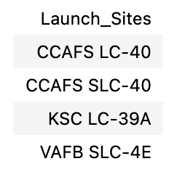
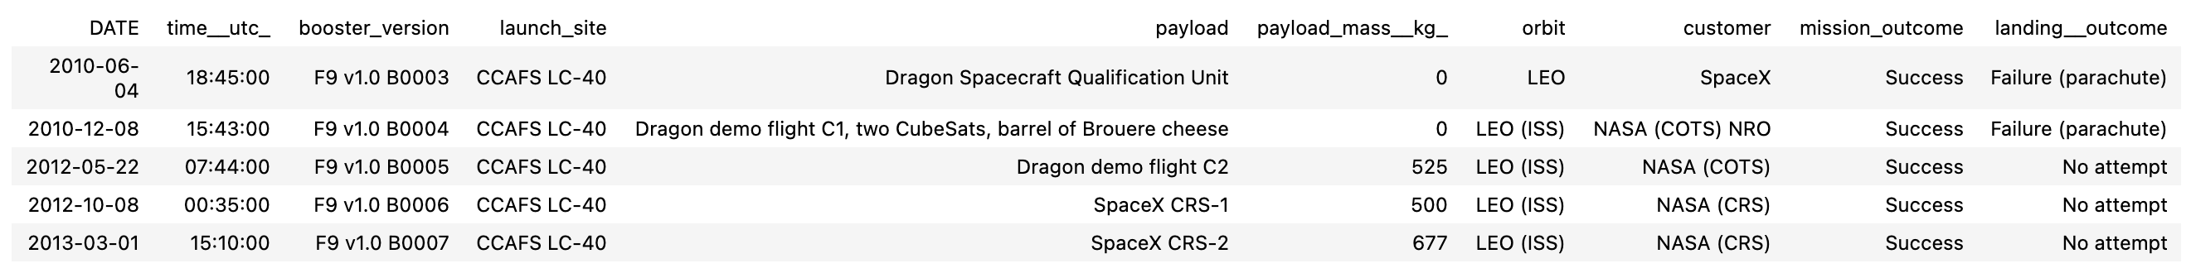
Results
The names of the unique launch sites in the space mission
5 records where launch sites begin with ‘CCA’

Slide 16
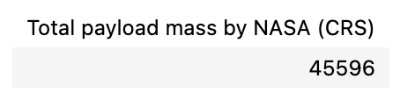
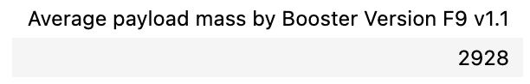
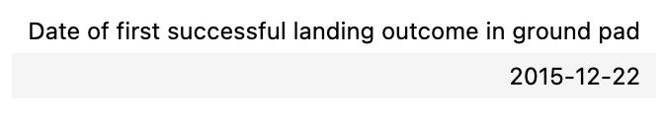
Results
The total payload mass carried by boosters launched by NASA (CRS)
The average payload mass carried by booster version F9 v1.1
The date when the first successful landing outcome in ground pad was achieved

Slide 17
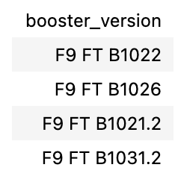
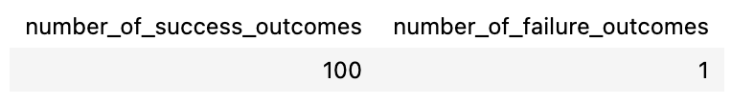
Results
The names of the boosters which have success in drone ship and have payload mass greater than 4000 but less than 6000
The total number of successful and failure mission outcomes

Slide 18

Section 2

Slide 19
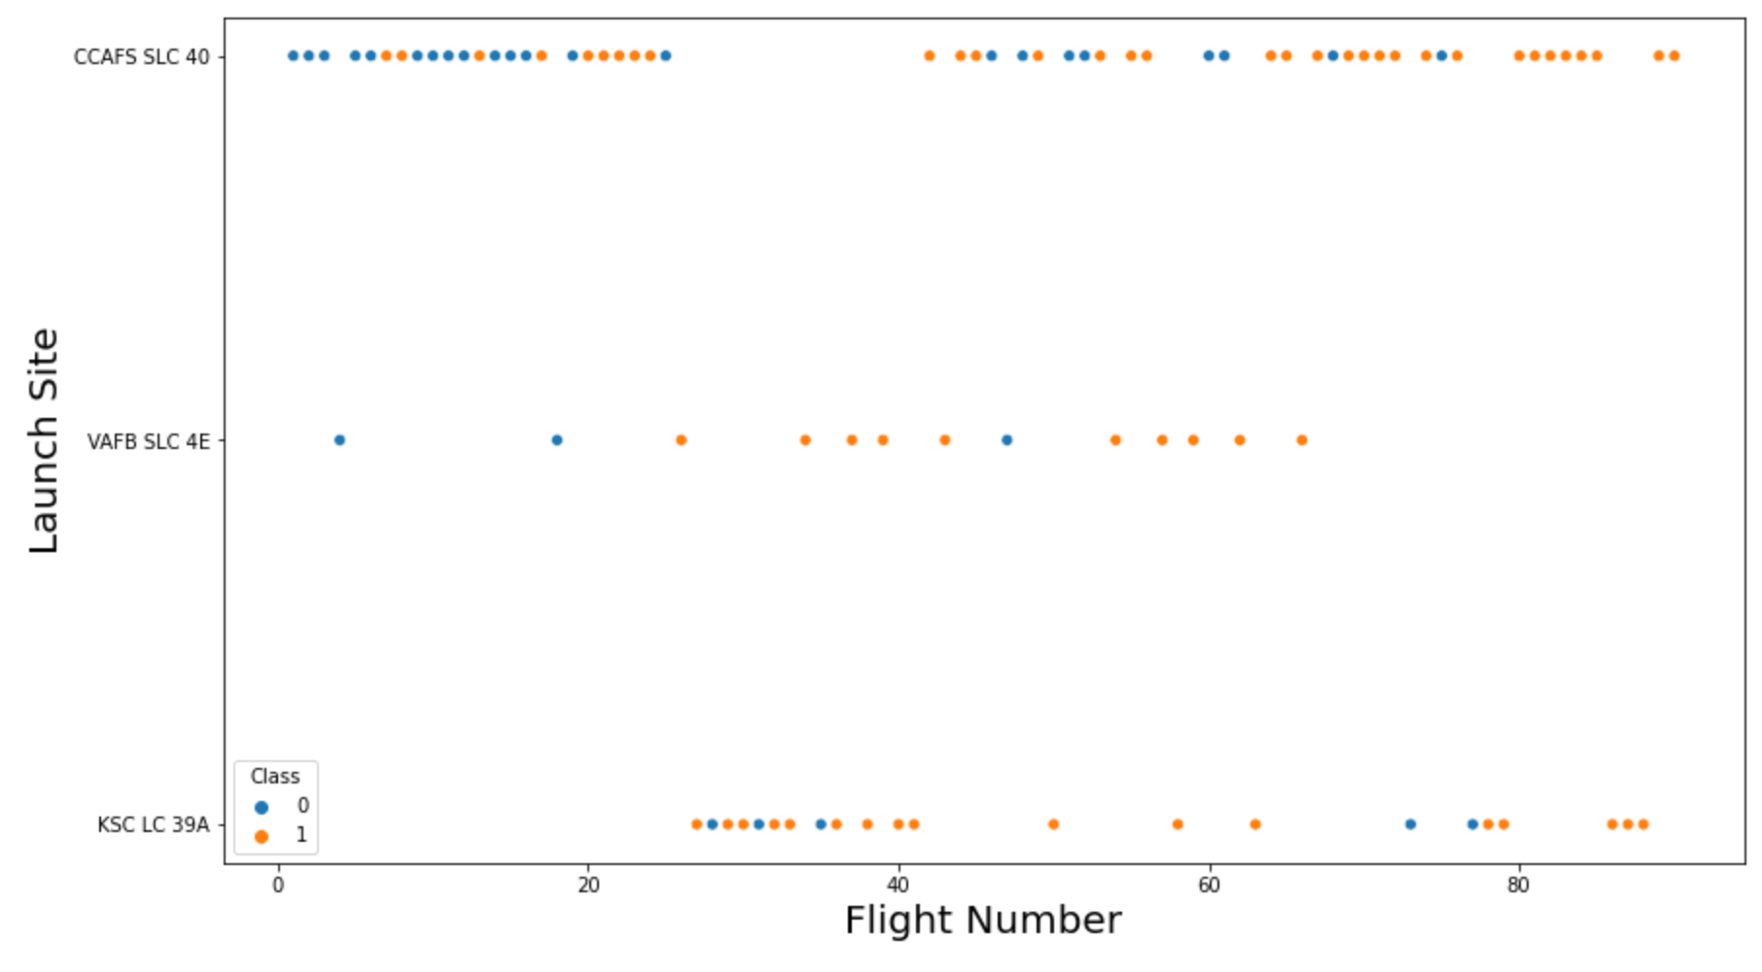
Flight Number vs. Launch Site

Slide 20
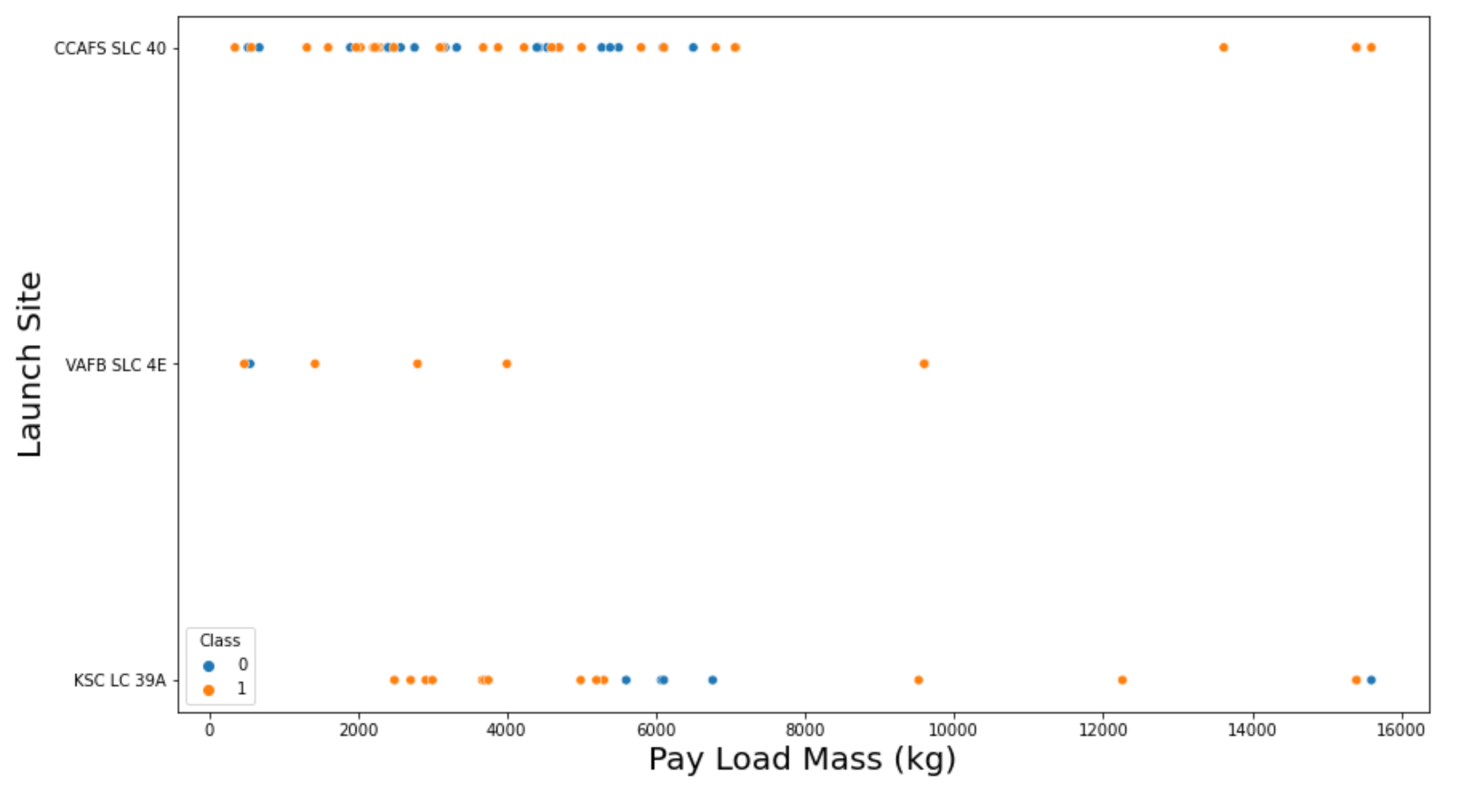
Payload vs. Launch Site

Slide 21
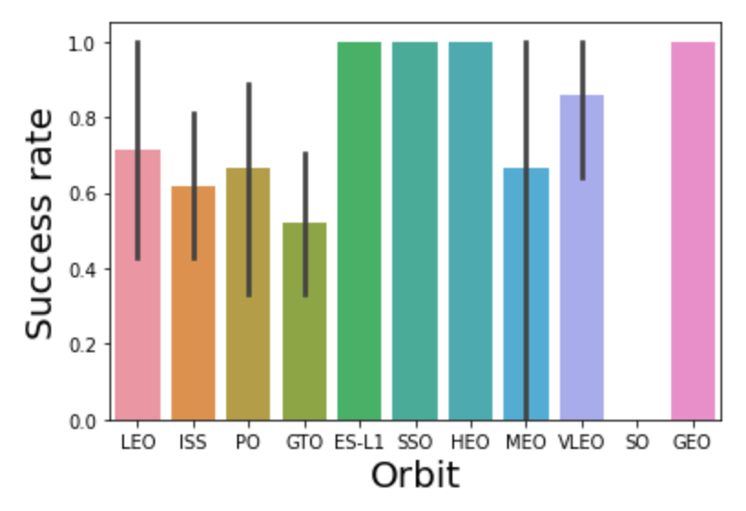
Success Rate vs. Orbit Type

Slide 22
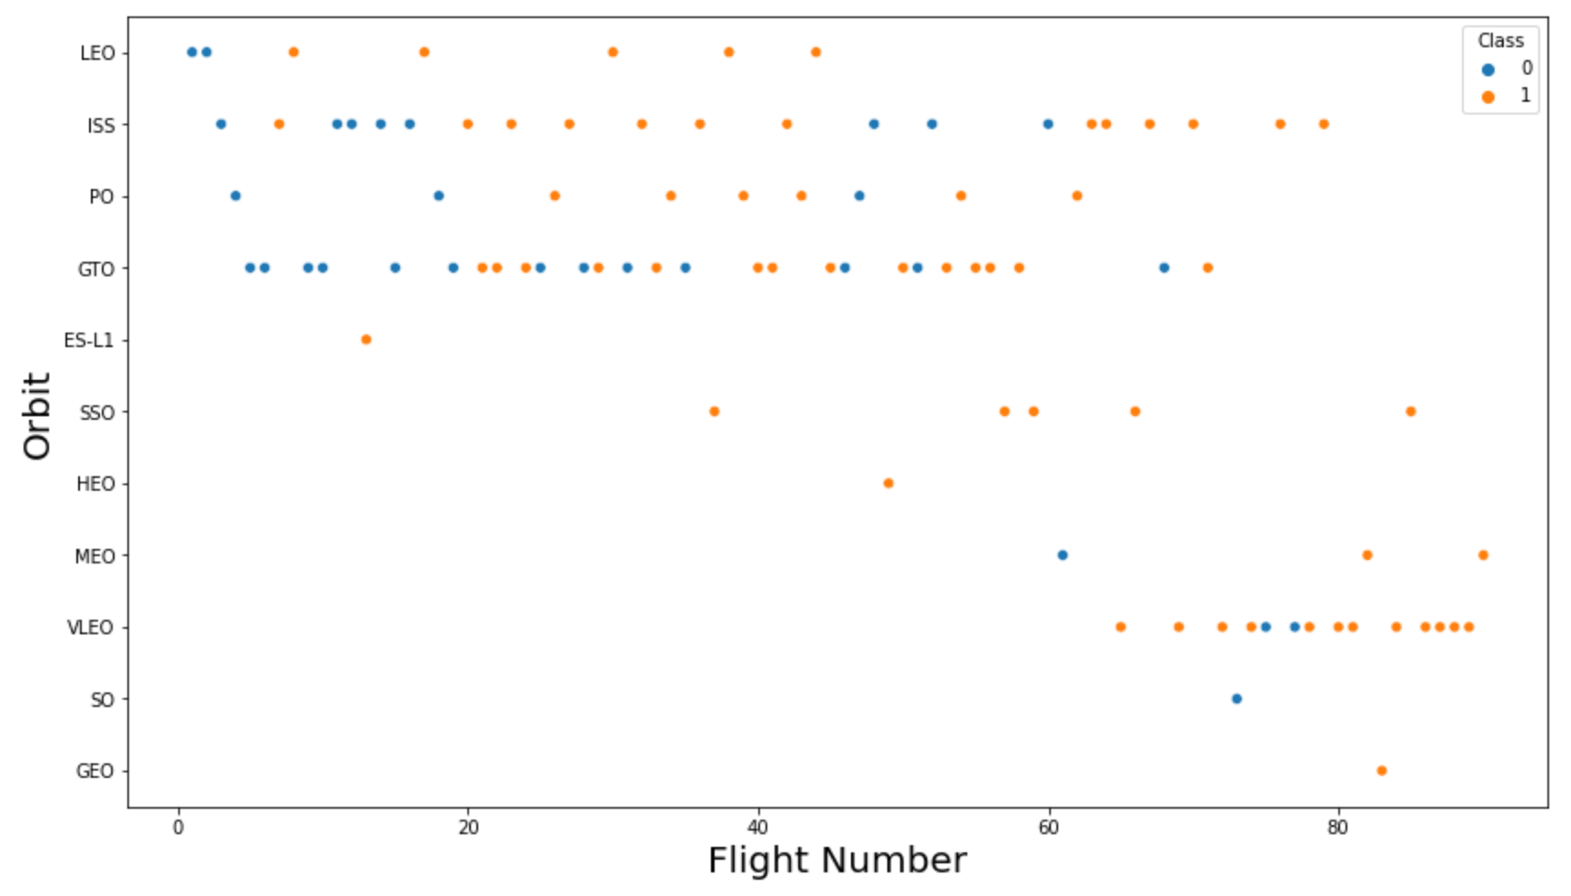
Flight Number vs. Orbit Type

Slide 23
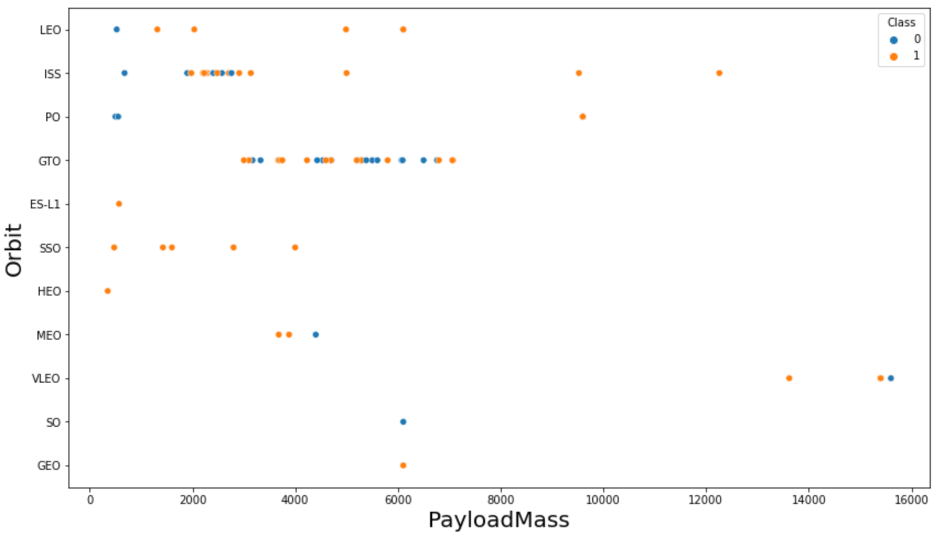
Payload vs. Orbit Type

Slide 24
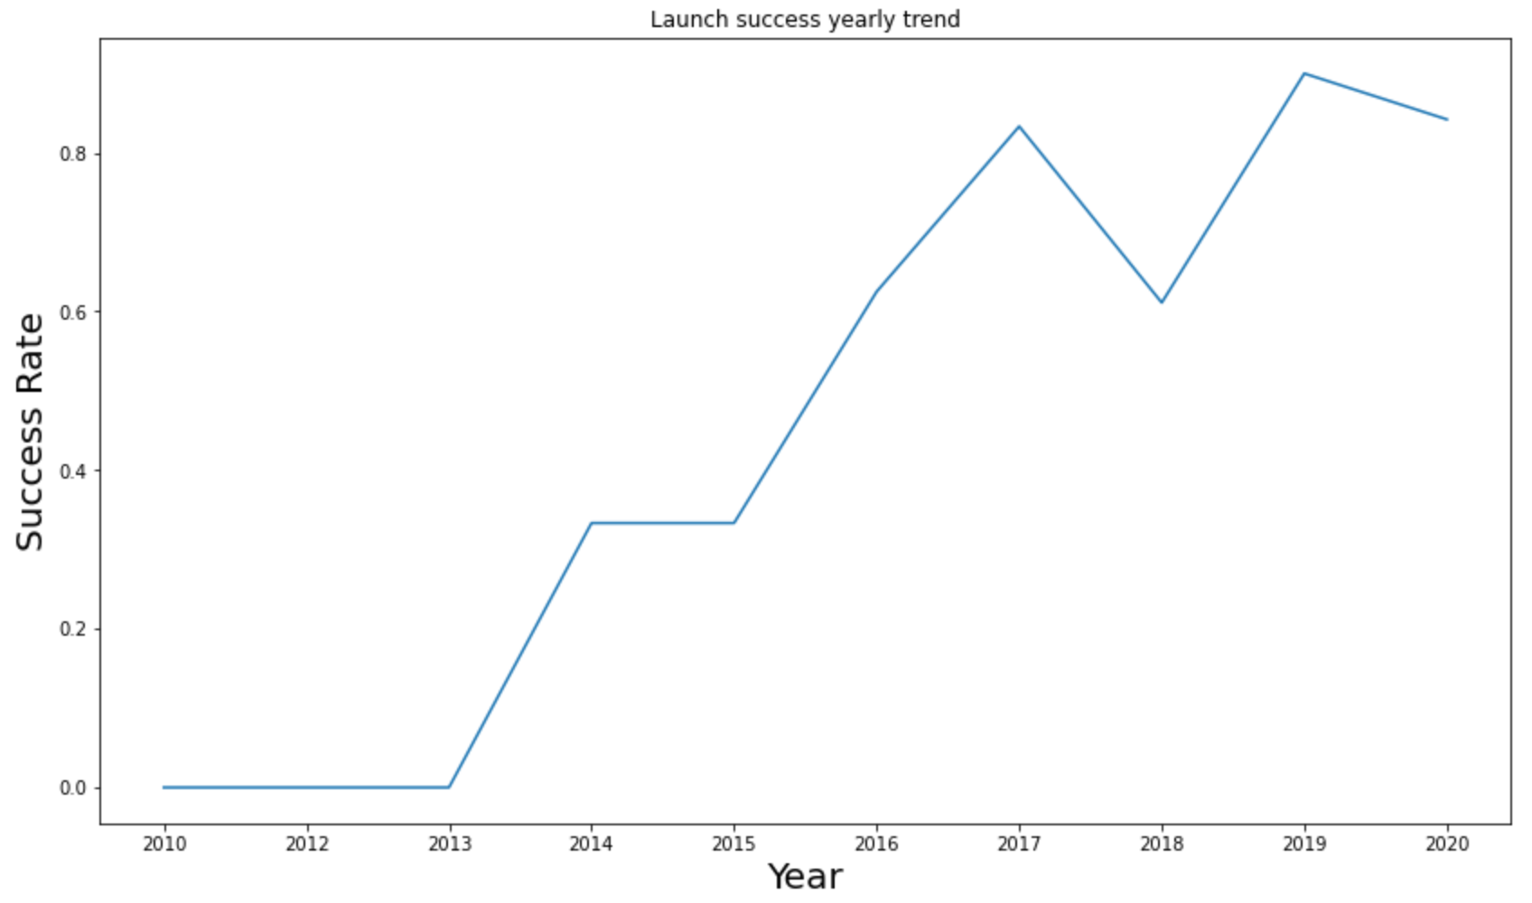
Launch Success Yearly Trend

Slide 25
All Launch Site Names

Slide 26
Launch Site Names Begin with 'CCA'

Slide 27
Total Payload Mass

Slide 28
Average Payload Mass by F9 v1.1
The average payload mass carried by booster version F9 v1.1

Slide 29
First Successful Ground Landing Date
The date when the first successful landing outcome in ground pad was achieved

Slide 30
Successful Drone Ship Landing with Payload between 4000 and 6000
The names of the boosters which have success in drone ship and have payload mass greater than 4000 but less than 6000

Slide 31
Total Number of Successful and Failure Mission Outcomes
The total number of successful and failure mission outcomes

Slide 32
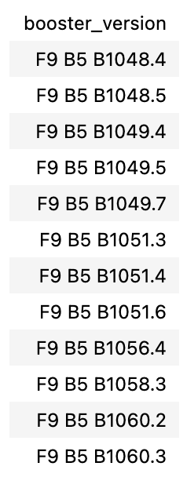
Boosters Carried Maximum Payload
The names of the booster versions which have carried the maximum payload mass

Slide 33
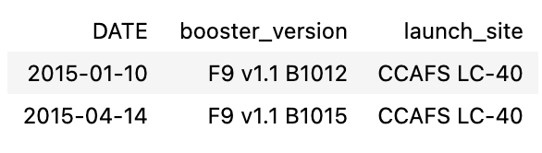
2015 Launch Records
The failed landing outcomes in drone ship, their booster versions, and launch site names for in year 2015

Slide 34
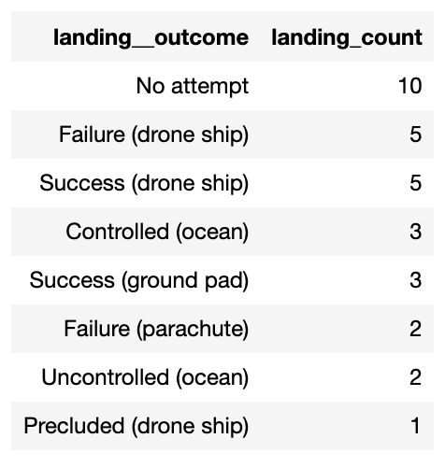
Rank Landing Outcomes Between 2010-06-04 and 2017-03-20
The count of landing outcomes between the date 2010-06-04 and 2017-03-20, in descending order

Slide 35

Section 3

Slide 36

<Folium Map Screenshot 1>

Slide 37
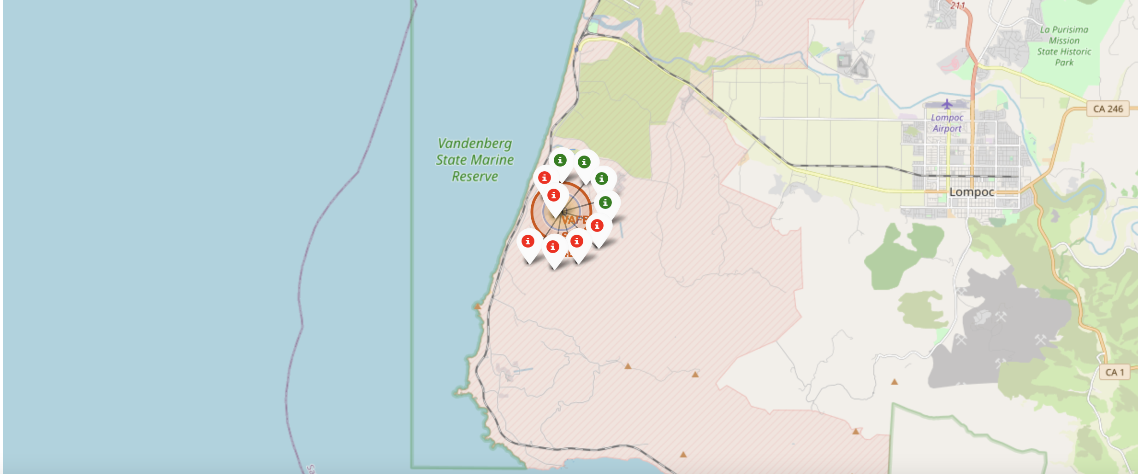
<Folium Map Screenshot 2>

Slide 38
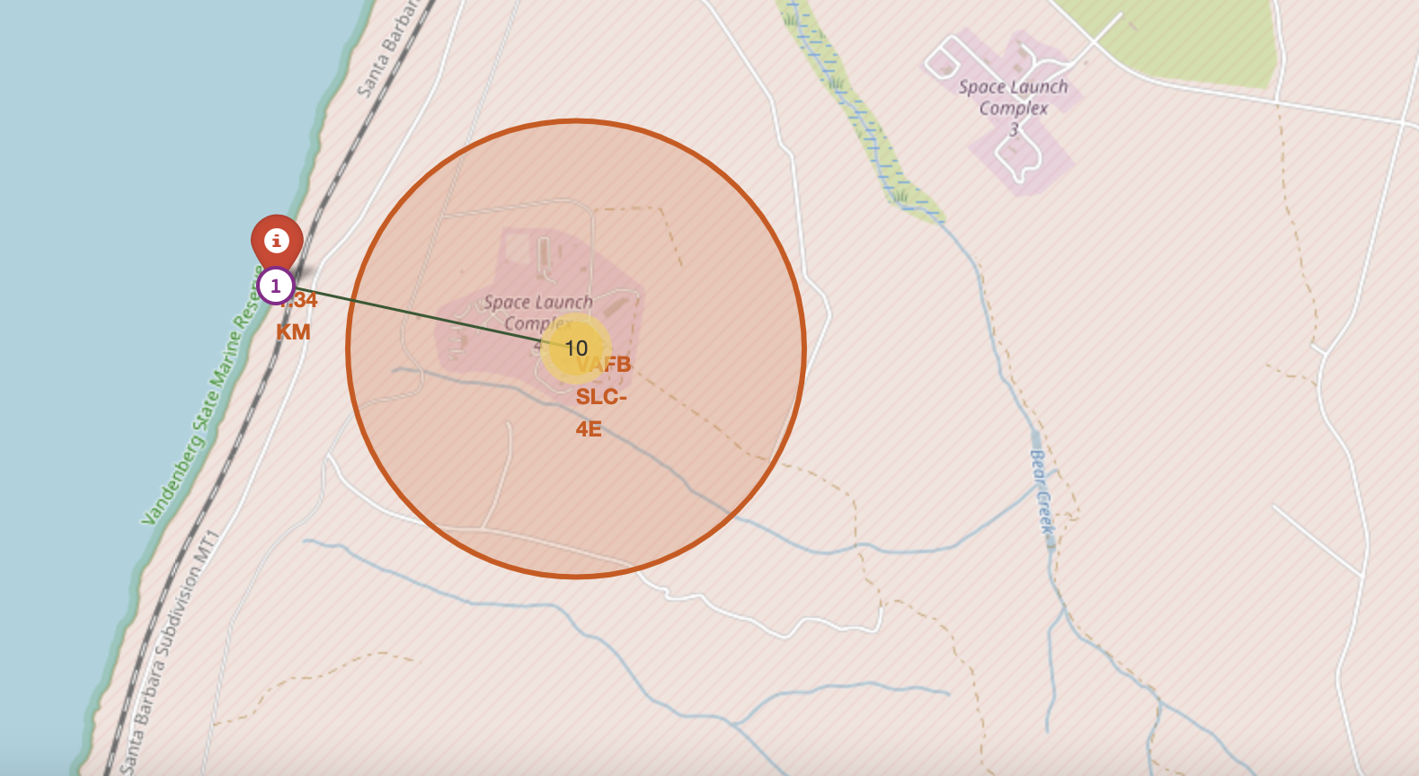
<Folium Map Screenshot 3>

Slide 39

Section 4

Slide 40

<Dashboard Screenshot 1>

Slide 41
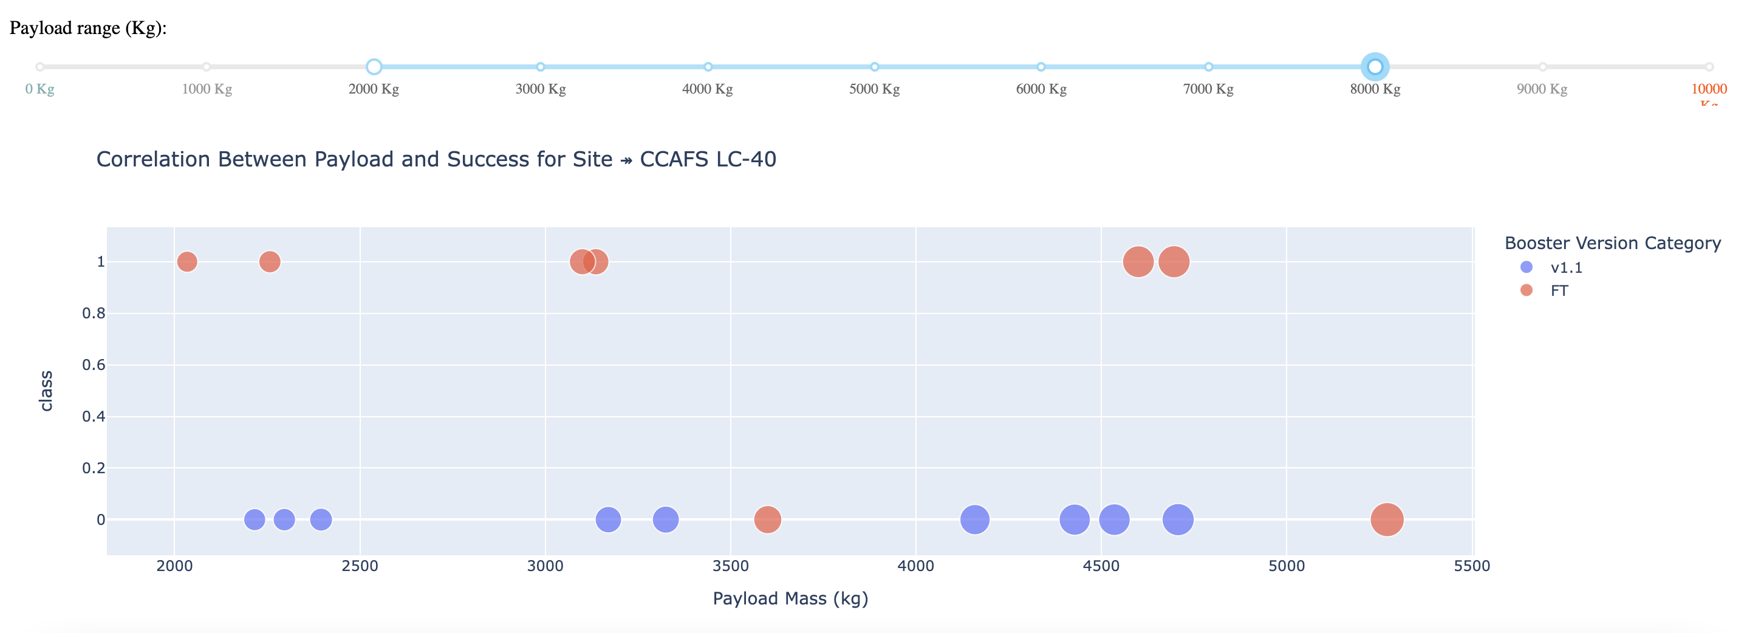
<Dashboard Screenshot 2>

Slide 42
<Dashboard Screenshot 3>

Slide 43

Section 5

Slide 44

Classification Accuracy
Logistic regression
GridSearchCV best score: 0.8464285714285713
Accuracy score on test set: 0.8333333333333334
Confusion matrix:

Slide 45
Confusion Matrix
Support vector machine (SVM)
GridSearchCV best score: 0.8482142857142856
Accuracy score on test set: 0.8333333333333334
Confusion matrix:

Slide 46
Confusion Matrix
Decision tree
GridSearchCV best score: 0.8892857142857142
Accuracy score on test set: 0.8333333333333334
Confusion matrix:

Slide 47
Confusion Matrix
K nearest neighbors (KNN)
GridSearchCV best score: 0.8482142857142858
Accuracy score on test set: 0.8333333333333334
Confusion matrix:

Slide 48
Conclusions
In this project, we aim to predict whether the first stage of a Falcon 9 launch will land successfully, which helps determine the cost of a launch.
Various features of a Falcon 9 launch, such as payload mass and orbit type, may influence the mission outcome.
Several machine learning algorithms are applied to past Falcon 9 launch data to create predictive models.
Among the four machine learning algorithms used, the decision tree algorithm produced the most accurate predictive model.

Slide 49


